Slide 1
TRAFFIC STOP DISPARITIES
JUVENILE JUSTICE
PRETRIAL
RELEASE
JURY POOL
FORMATION
Report by Dr. Frank Baumgartner on ten years of traffic stop data across North Carolina.
Report by Dr. Susan McCarter on the School to Prison Pipeline
Partnering with NCCD to develop risk assessments in public schools.
ABA RJIP Project in Halifax County to develop a pretrial risk assessment.
Sponsoring research at the SOG on jury pool formation in Orange and Chatham Counties.

Slide 2
Halifax County Task Force
Members:
Melissa Pelfrey, District Attorney Halifax County
Judge Brenda Branch, Chief District Court Judge
Jay Burch, Halifax County Sheriff’s Office
Rebecca Spragins, Clerk of Court Halifax County
Cynthia Pitchford, Chief Magistrate Halifax County
Tonza Ruffin, Halifax County Defense Attorney

Slide 3
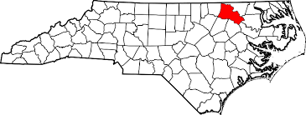
Halifax County, North Carolina
Rural, mostly agricultural area
Democratic majority
Population 55,000
Black non-Hispanic 53%
White non-Hispanic 39.4%
American Indian 3.7%
Hispanic 2.1%
Asian .7%
Two or more races 1%
Median household income $29, 490
Processed 163 felony convictions in 2011-12

Slide 4
Halifax County Research
100 cases, Class H
Property & low level drug crimes
Raw data analysis & regression analysis controlling for criminal history
Limitations--no single source of data in NC
Goal is to get to 500 cases—of all felonies, not just Class H

Slide 5
Pretrial Release in Halifax County
Initial Appearance with Magistrates; First Appearance with District Court Judge
Exceptions: DWI and DV cases
No Pretrial Services office or probation involved in bond hearings; Defendants usually unrepresented at first two bond hearings
Generally a D must have conditions of pretrial release determined, N.C.G.S. 15A533(b)
The statutory presumption is for a non-secured bond amount, with exceptions

Slide 6
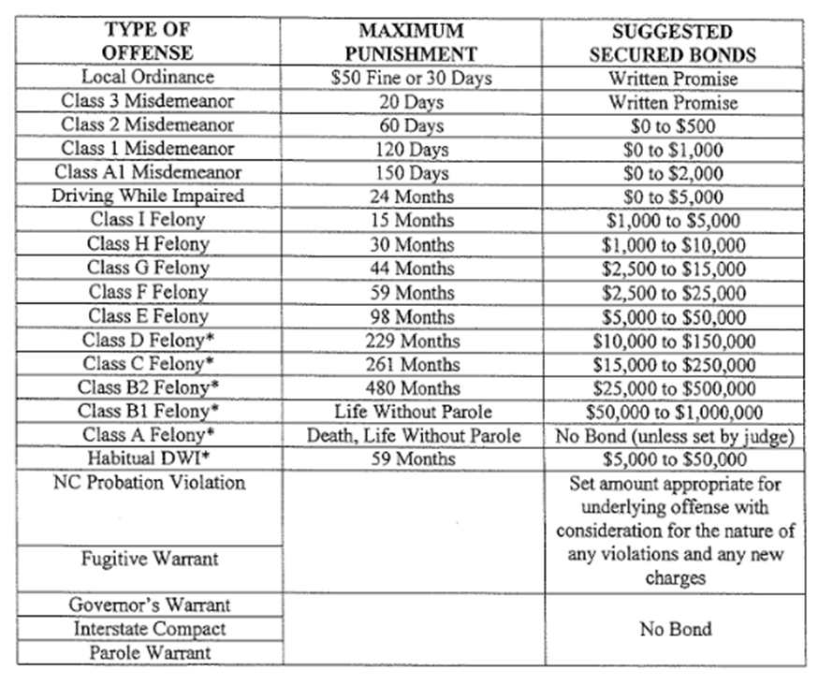

Slide 8
Types of Bonds, by Race
80.3%

Slide 9
Types of Bonds Set

Slide 10
Length of Stay

Slide 11
Factors in Bond Determination
Number of Associated Cases
Prior FTAs
Number of Offenses
Prior Infractions
Residency
Gender
Prior Felony Arrests
Race
Age
Prior Felony Convictions
Prior Misdemeanor Convictions
Prior Traffic Convictions
Prior Misdemeanor Convictions

Slide 12
Factors in Bond Determination
Number of Associated Cases
Prior FTAs
Number of Offenses
Prior Infractions
Residency
Gender
Prior Felony Arrests
Race
Age
Prior Felony Convictions
Prior Misdemeanor Arrests
Prior Traffic Convictions
Prior Misdemeanor Convictions

Slide 13
Halifax County
Halifax is doing well with racial equity, at least according to this imperfect analysis (need more samples)
We have willing partners in Halifax that are ready to create and promote innovative and cutting edge reforms to their pretrial release policies and practices

Slide 14
HALIFAX COUNTY PRETRIAL RELEASE BEST PRACTICES
Grand Jury Room, Halifax County Court House
10:00 am – 2:00 pm
Overview of Pretrial Release in North Carolina
Jeff Welty, Associate Professor of Public Law and Government, UNC School of Government
Professor Welty summarized the law of pretrial release in North Carolina, highlighting differences in how the law is applied across the state, and discussing practical considerations for public officials involved in the pretrial release system.
Pretrial Best Practices & Pretrial Release Reforms from Other Jurisdictions
Tim Murray, Director Emeritus, Pretrial Justice Institute
Mr. Murray discussed the purpose of bail and the outcomes associated with current practices. Mr. Murray then described national efforts to reform pretrial justice and discussed what has been done in specific sites to achieve pretrial outcomes that more safe, effective, and fair.

Slide 15
Halifax County Risk Assessment
Residency
1+ years, contribute to payments-0
1+ years, do not contribute to payments-1
Less than a year, but contribute to payments-2
Less than a year and do not contribute to payments or homeless-3
Criminal History
None-0
Past Jail Sentence-1
Past Prison Sentence-2
Pending Charges
No-0
Yes-1
Currently on Supervision
No-0
Yes-1
Charge Type
Misdemeanor-0
Felony-1
Past Failures to Appear
None-0
One-1
Two+-3
History of Revoked Bond
No-0
Yes-1
Drugs/Alcohol
Neither-0
Alcohol abuse/treatment-1
Drug abuse/treatment-2
Mental Health Treatment
Have never received-0
Have received outpatient treatment-1
Have received inpatient treatment-2
Age at First Arrest
No prior arrests-0
35+ years- 1
25-34 years-2
16-24 years-3

Slide 16
Risk Levels & Score Ranges
Level 1: 0-3
Level 2: 4-8
Level 3: 9-12
Level 4: 13-16
Level 5: 17-19
WPA, Custody Release
Unsecured Bond, low range
Unsecured Bond, high range
Secured Bond, low range
Secured Bond, higher range

Slide 17
Next Steps
Finalizing Risk Assessment particularized for Halifax County
Applying the Risk Assessment to 300 closed cases to test efficacy
Apply results to a new Risk Assessment for piloting in Halifax County
Continue data collection to get sound results on initial study

